Slide 1
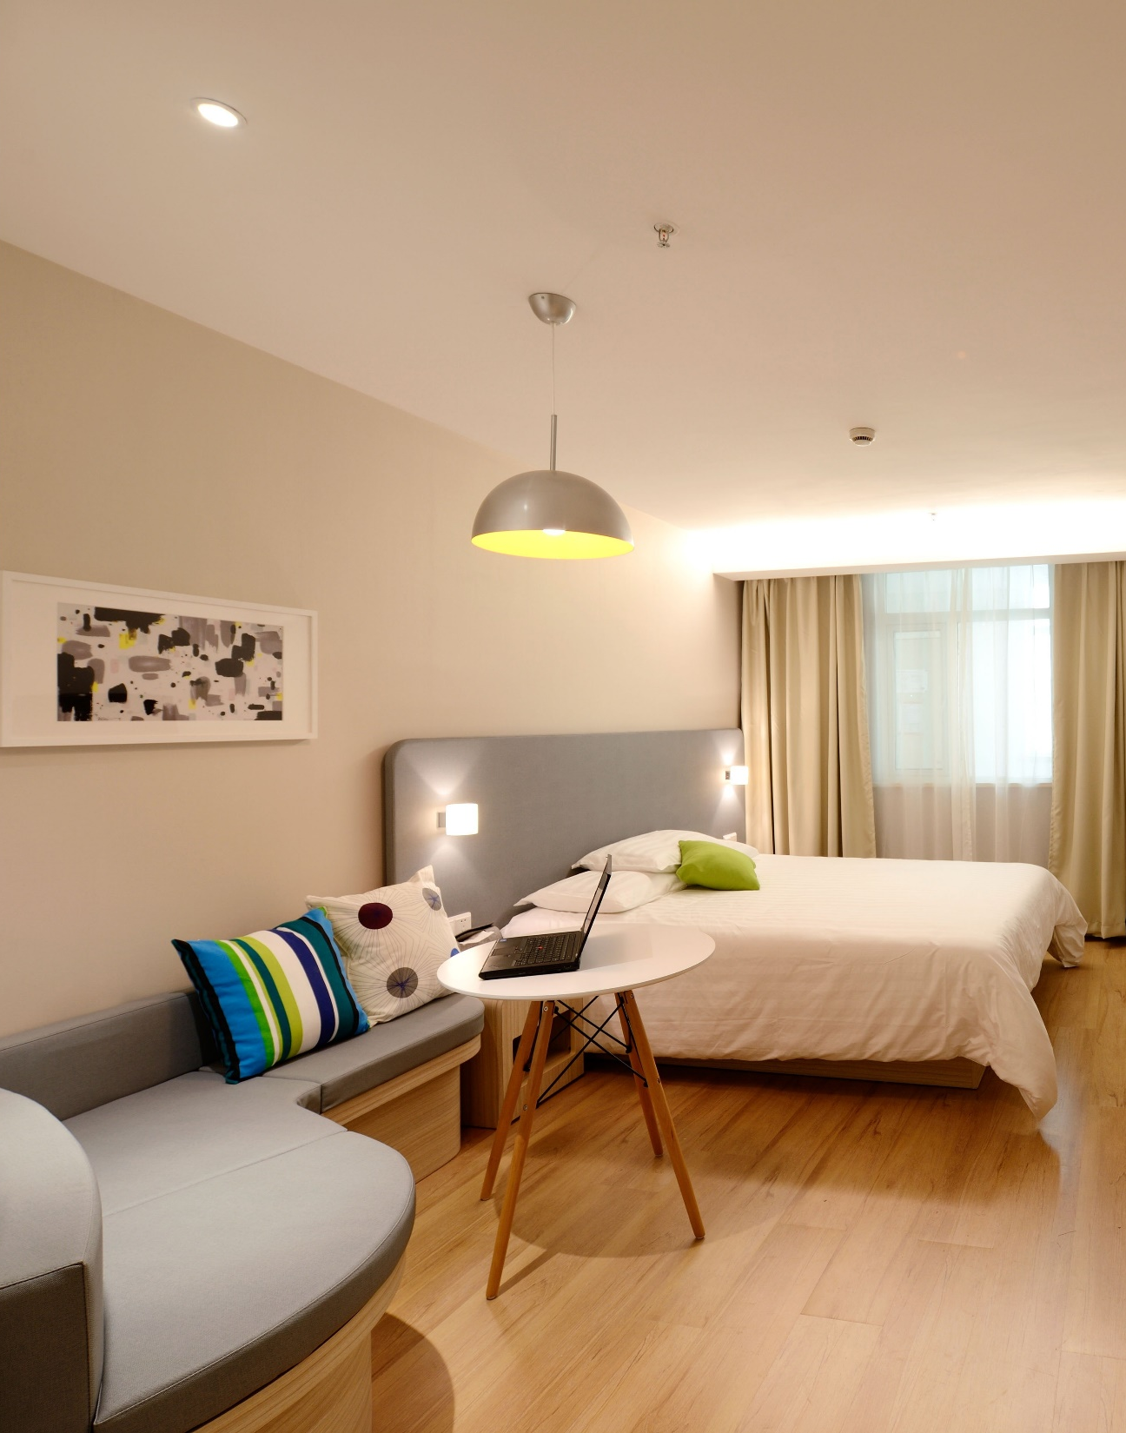

Host Behavior Analysis

Slide 2





Meet The Team
Ankit Raghuvanshi
Rajneesh
Simran Batra
Data cleaning and Preprocessing
Data Analysis.
Data Visualization.

Slide 3
Client Intro
Our client is an online community market place that connects people looking to rent their homes with people who are looking for accommodation.
Founded in San Francisco in 2008 as a start-up, the company has become a worldwide booking platform.
Today it contributes to the movement of more than 60 million people in 192 countries.

Slide 4
Objective
The purpose of this analysis is to understand what makes a host a super host, More or less the host behavior and find trends in Airbnb host behavior, and identify gaps in what listings offer versus what Airbnb customers are looking for.
The data includes listings and reviews and covers the Toronto, Vancouver, Beijing, Dallas, Austin, Athens etc. area.
The 'Listings' dataset includes information about each property and corresponding host, such as number of bedrooms, weekly/monthly price, instant bookable, and whether the host is a super host. The 'Reviews' dataset includes the reviews text, listing ID, reviewer ID, and date.

Slide 5
Aim
The company wants to comprehend how host behavior varies across a variety of metrics like:
Draw the distinction between Super Host and Other Hosts on the basis of Acceptance rate, response rate, instant booking, profile picture, identity verified, review scores etc.
Identify the top 3 crucial metrics one needs to maintain to become a Super Host and also, find their average values.
Analyze how the comments of reviewers vary for listings of Super Hosts vs Other Hosts.
Analyze do Super Hosts tend to have large property types as compared to Other Hosts

Slide 6
Cancelation Rate

Slide 7
Acceptance Rate

Slide 8
Response Rate

Slide 9
Positive Comments

Slide 10
Conclusion & Recommendations:
Superhosts have a higher average reviews per month and are more popular, per the assumption made earlier (reviews per month is a reasonable estimate for popularity). However, We did some research on what it takes to become a super host and it does not account for the number of bookings the host gets per period of time. It just requires 10 completed trips total per host. This might be misleading to guests because they wouldn't know if the high ratings and superhost status were from over a year ago or if they still hold true as of a month ago, for instance. To address this concern, Airbnb could add a "last booking for this host" update that users can see. To see if this actually encourages more bookings, A/B testing can be used where one version includes this status update while the other does not.
Over the past few years, the number of new hosts in this area has not shown any upward trend. This might be a concern and further analysis using statistics/modeling can help us understand why the number of new hosts has stagnated.
One interesting Airbnb guest behavior observed was the tendency to stay at the same 1 to 3 listings and review them many times. First, we need further investigation to see if this is an emerging trend or if these users are anomalies. If it is an emerging trend, Airbnb could implement customer loyalty programs to encourage such behavior.

Slide 11
Limitations of this analysis:
This dataset provided detailed information about the listings, but there was not enough information about the hosts or guests. For instance, we don't know the guests' bookings, only their reviews. This means we can't calculate the reviews to bookings ratio, which is probably an important metric for Airbnb. We also aren't able to segment or target Airbnb guests because there is so little information about them in this data. Purpose of their stay would be a really useful attribute to know, for example.
The data provided the "host since" variable, which is great for tracking the number of new hosts gained. However, we don't have a variable tracking the number of hosts lost, which means we can't estimate the total number of active hosts over time. This is an important metric to track because it represents Airbnb user engagement and its supply of hosts in various regions.

Slide 12
Thank You

